Slide 1

LAST DanCE
Shimin 2022-09-05

Slide 2
What is DevOps?

Slide 3
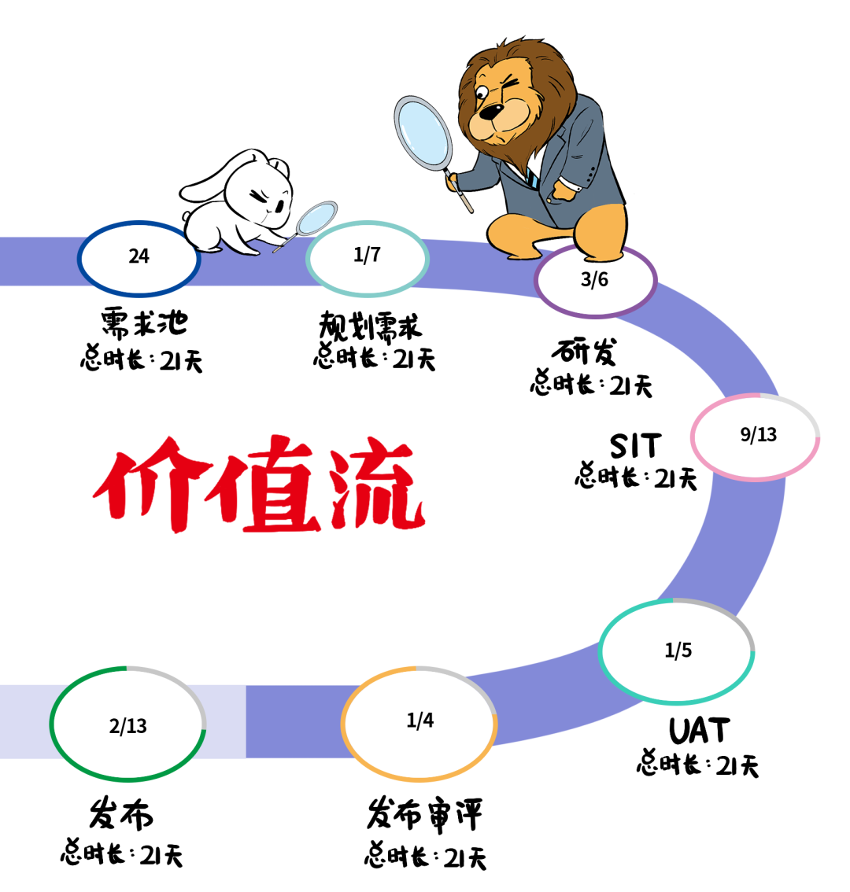
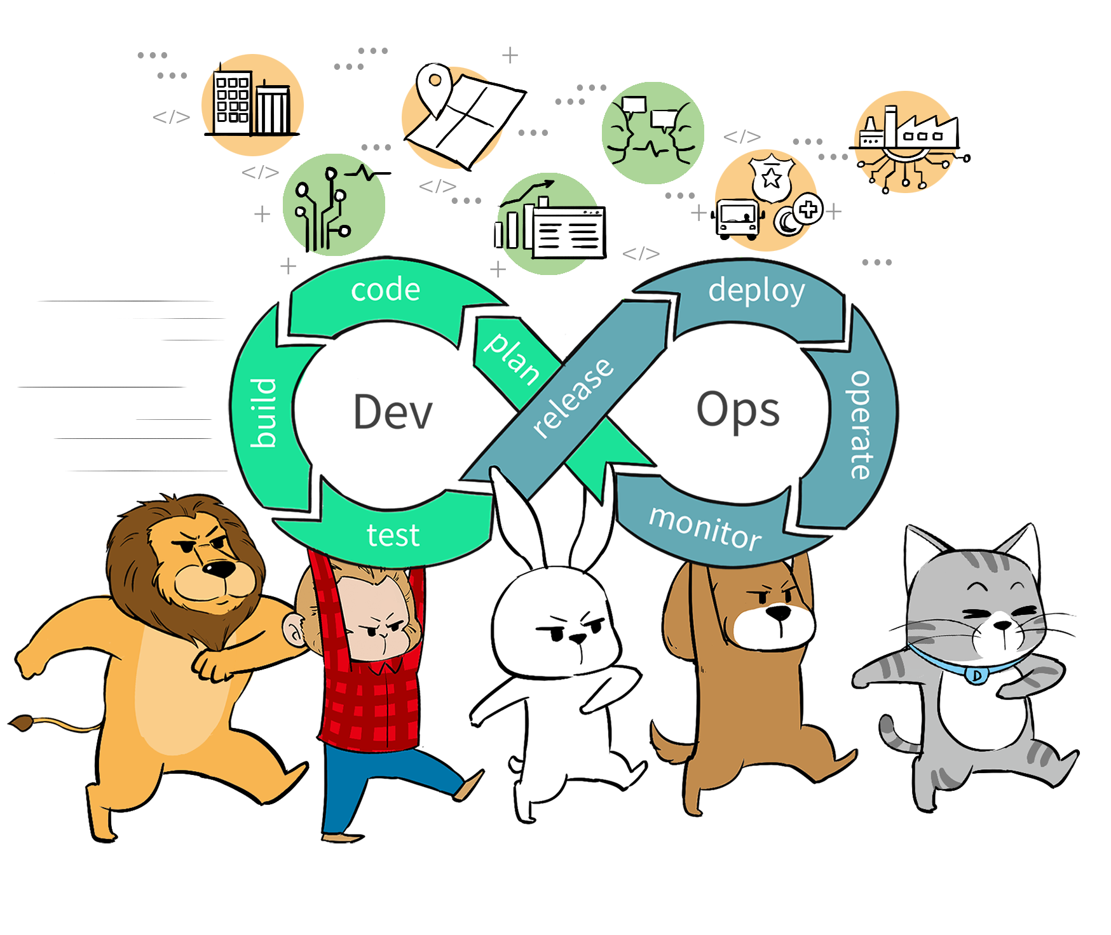
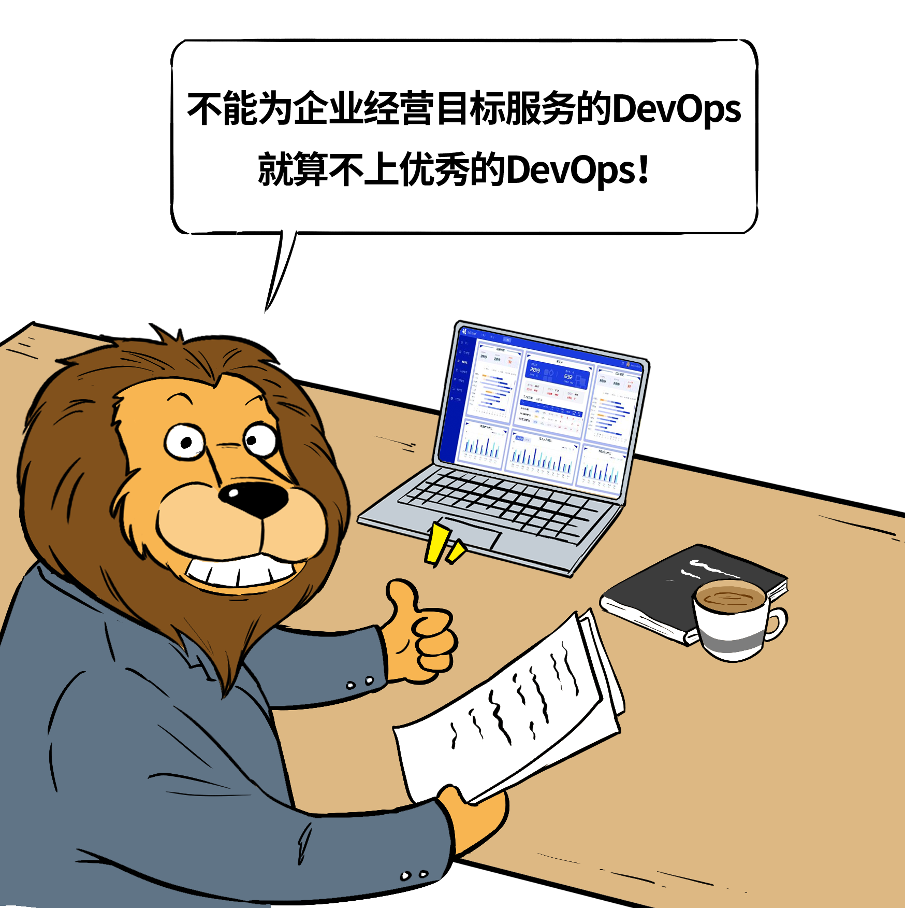

Slide 4
What is LightSpeed?

Slide 5

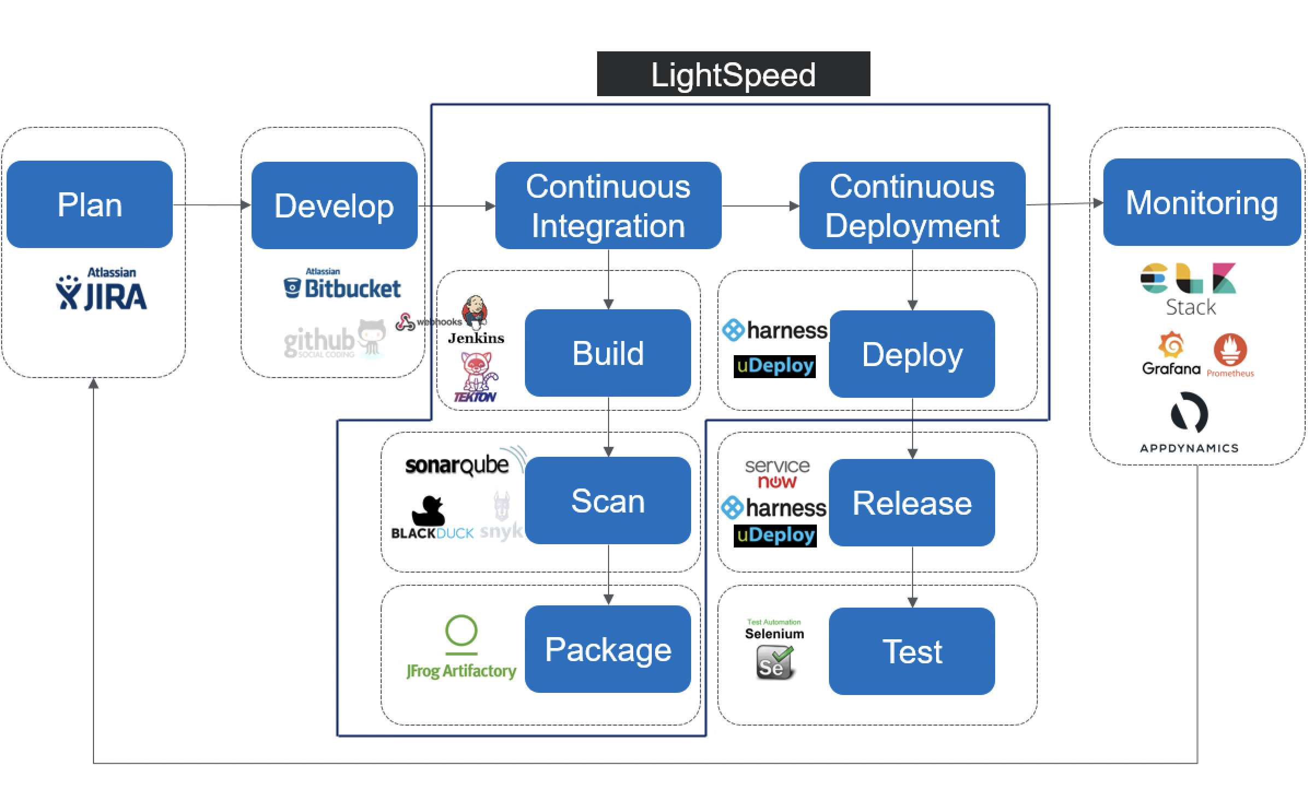
LightSpeed is a toolchain. It saves time of communication and waiting for human triggers, avoids human error
The whole process starts with pushing the code in bitbucket and ends with Udeploy deploying the image
LightSpeed Enterprise use Tekton, SonarQube, BlackDuck, Artifactory, Harness, ServiceNow and OpenShift
LightSpeed is a DevOps tool which based on infrastructure as code, document as code
LightSpeed Classic use Jenkins, SonarQube, BlackDuck, Artifactory, UDeploy, ServiceNow and OpenShift

Slide 6
How Does lightSpeed Classic works?

Slide 7
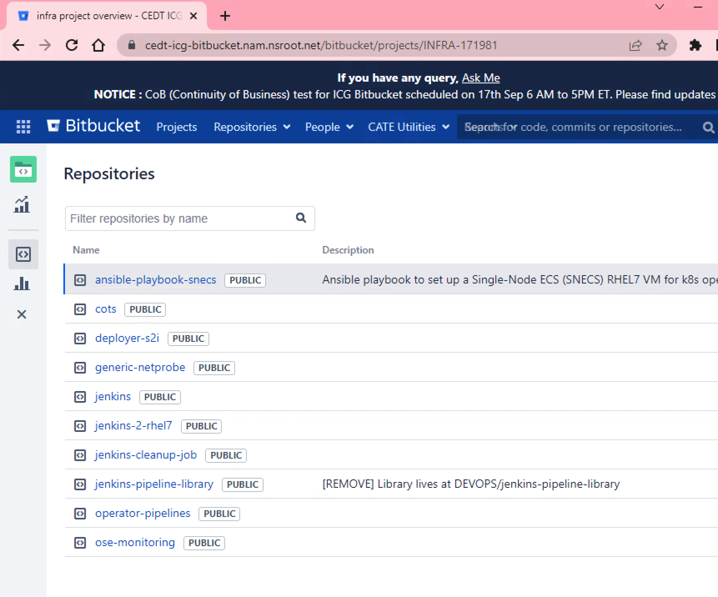
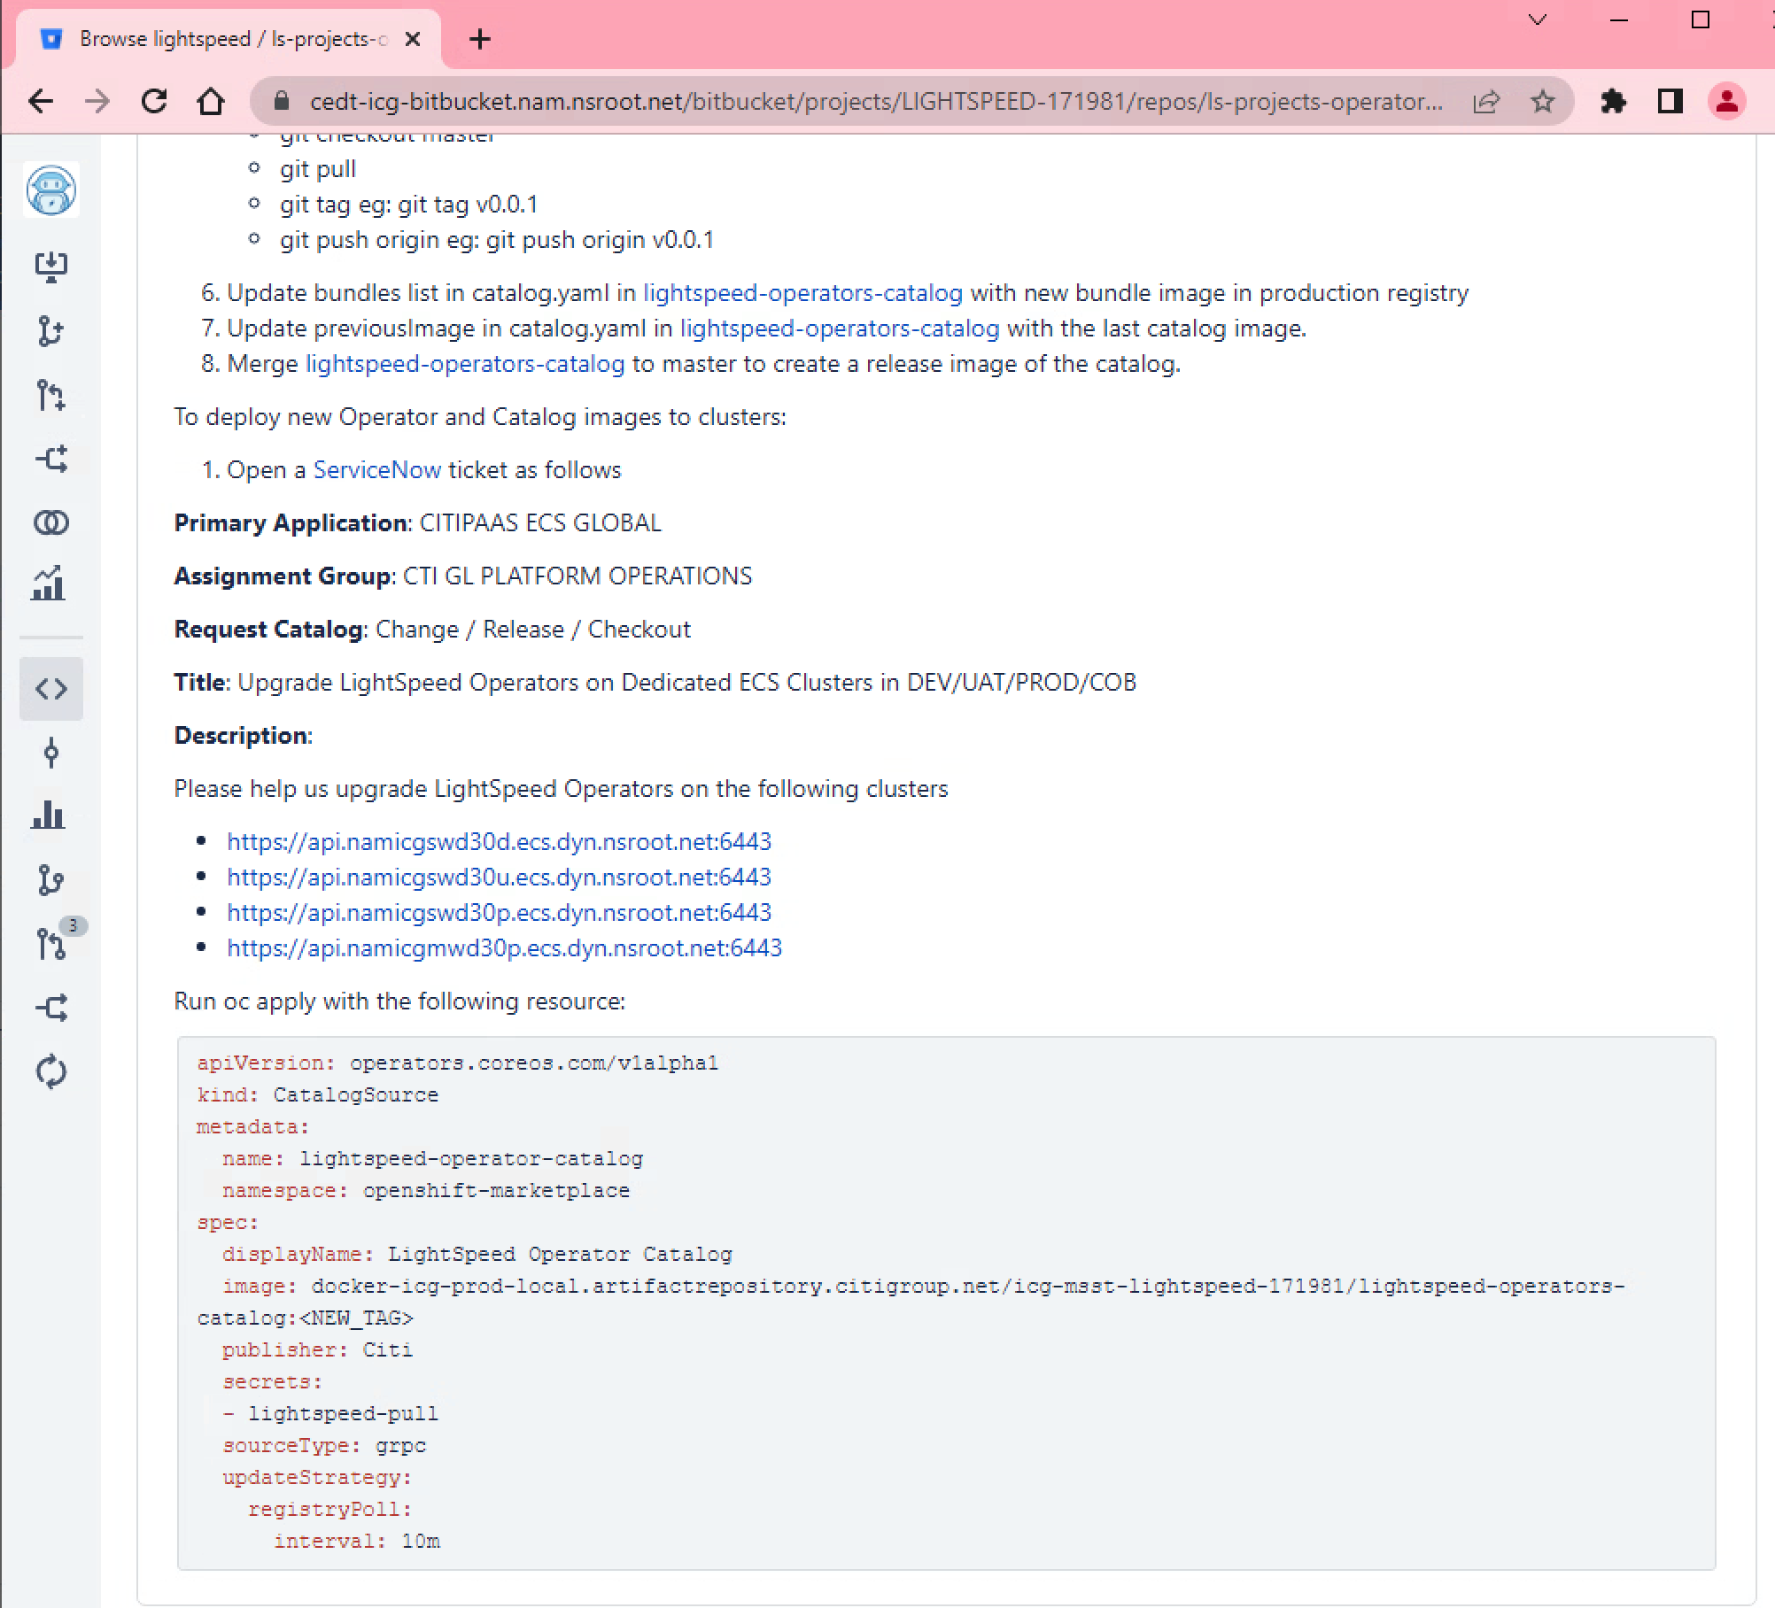
Infrastructure as code

Slide 8
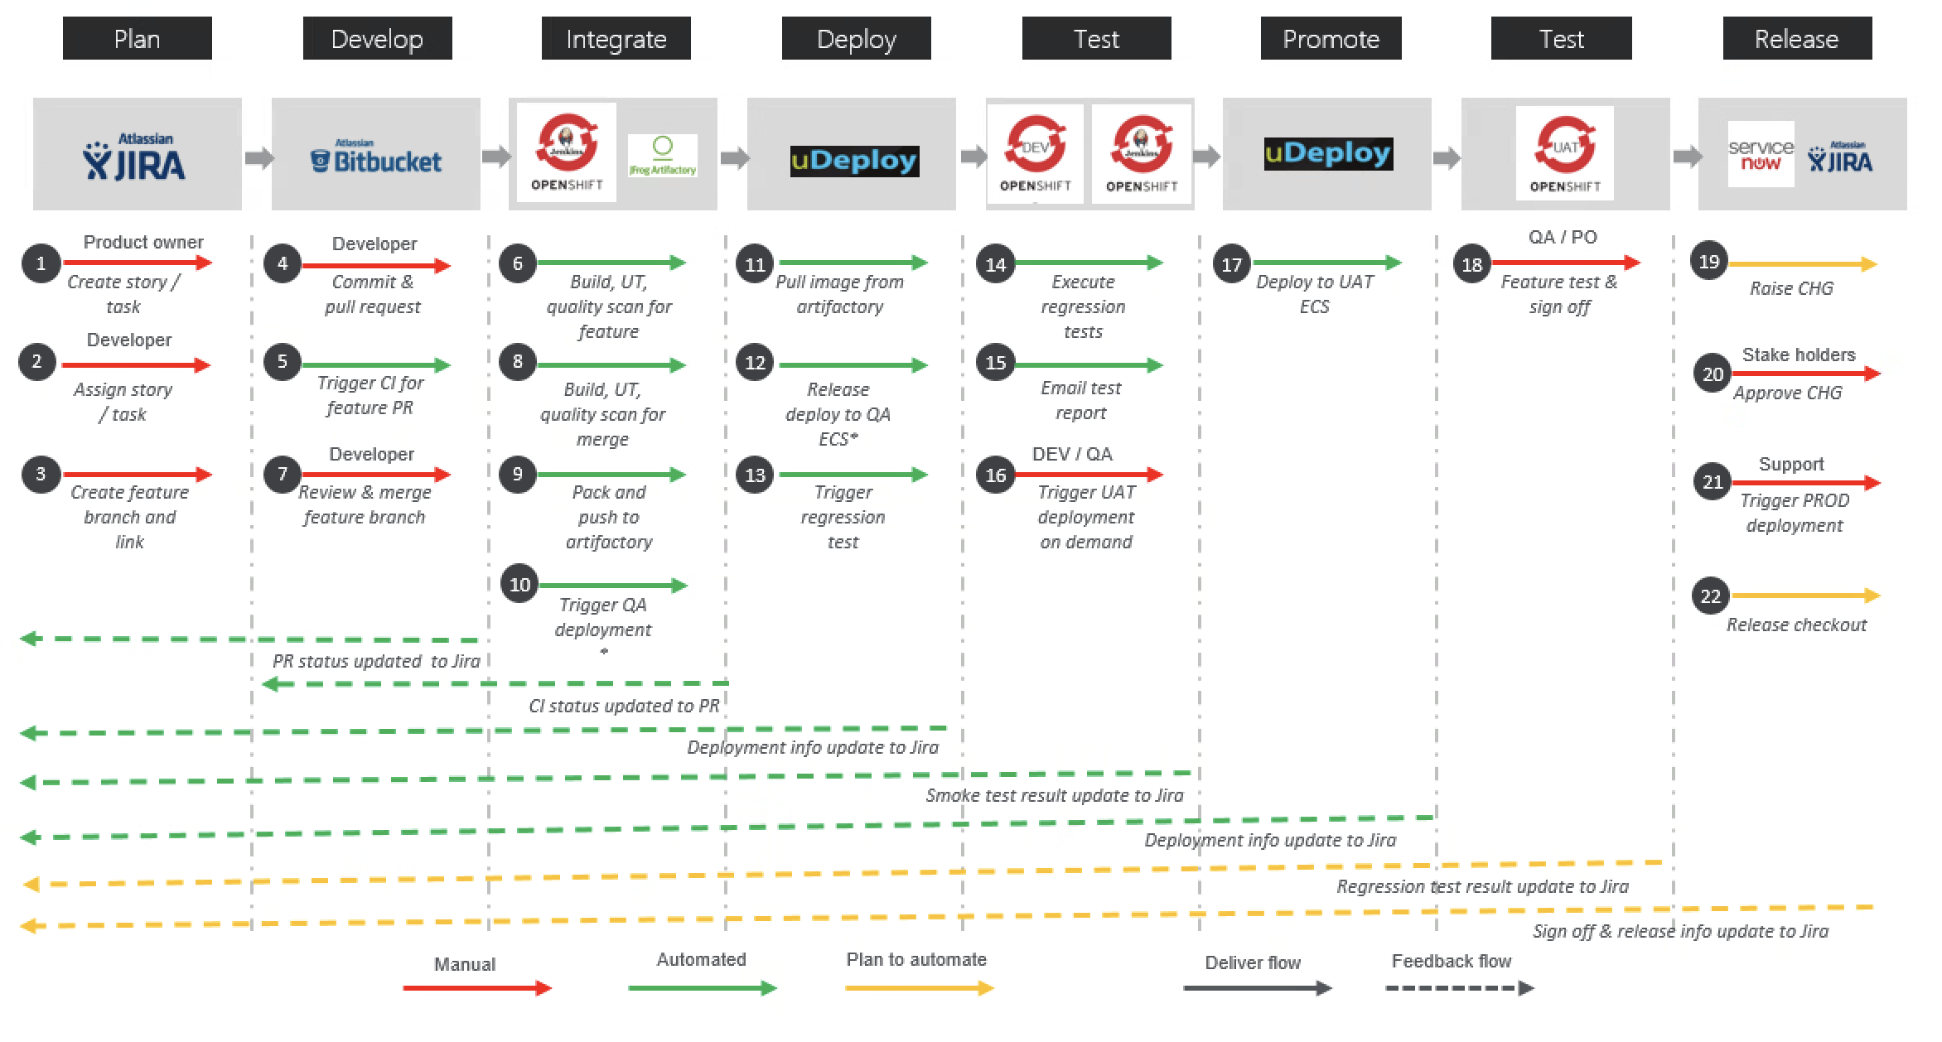

Slide 9
What are the most common questions you think are worth sharing?

